Slide 1
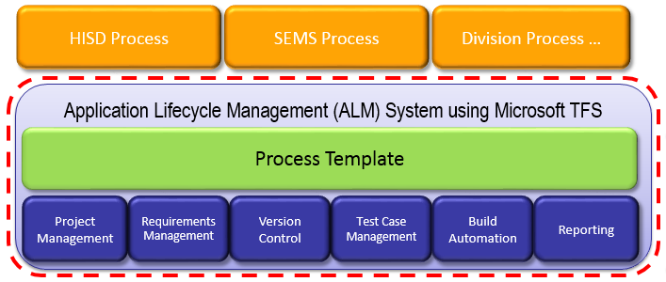
Software Factory: Enterprise Team Foundation Server
Objective: Provide an Enterprise Application Lifecycle Management Service for all 3M Software teams.
Contacts:
Mike O’Brien, Toby Hable
Status: NTI-Explore
Collaborators:
3M IT
HISD
TSSD
Progress:
Cost of Service Complete
HIS Team onboarding (ongoing)
Engage with Microsoft MCS team
656 Users as of Sept 8
January-August Division Chargeback
Multiple Divisions engaged – HIS, IPD, TSSD, PSD
Define and initiate System Governance
Construct Enterprise Build Services
Define and implement Export Control services for ALM (ETFS-EC)
Define External Access
Implement external access
Construct Enterprise Test Services
Onboarding of teams (ongoing)
Applications (Division): HISD, IPD, TSSD(MVSS,SSD), PSD, Unitek, IT
Technology:
Establish an Application Lifecycle Management (ALM) support system by leveraging Microsoft Team Foundation Server (TFS).
Value Proposition:
Centralization of software development infrastructure provides Enterprise class quality, uptime and support at a lower cost.
Develop team of ALM specialists to support 3M software businesses
Process / Optimization
Project Management
Requirements Management
Design & Architecture
Release Management
Development
QA & Test
Application Lifecycle Management (ALM)

